Slide 1
Effect of Inhibitory Gamma Rhythm Conductance on Nonlinearity
2/6/2024

Slide 2
GOAL
We have now optimized the inhibitory synapse configuration and timing in our model. We are interested in determining the effect of increasing inhibitory conductance of GABA synapses in the background gamma rhythm on the nonlinearity of the dendrite.

Slide 3
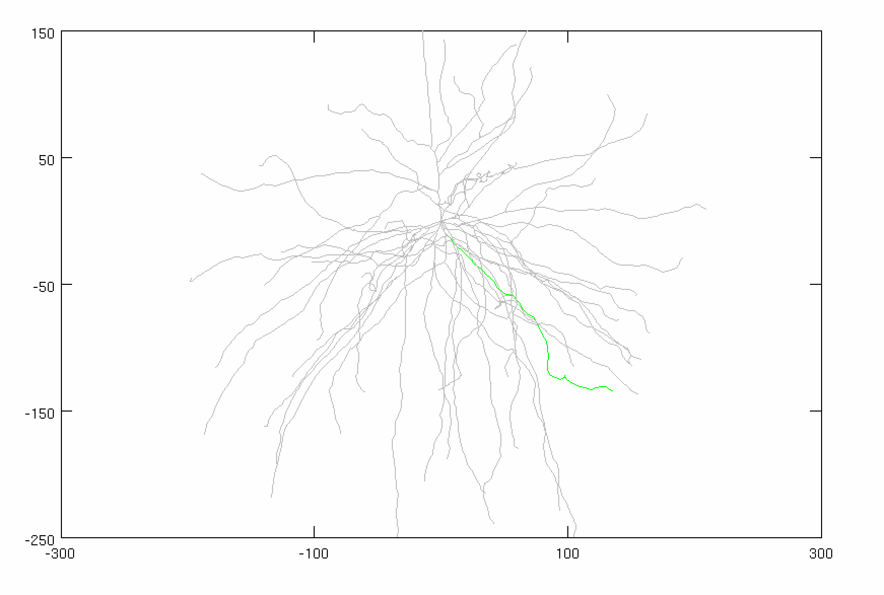
Model Parameters
Inhibitory Gamma
N_syn = 30 (ON SOMA)
Firing rate: 50 Hz
Distribution: 3 ms
Conductance: VARIABLE
Adjusted Current
Amplitude: VARIABLE
Noise: 0 nA
Stimulus
Total synapses: 40 synapses
AMPA: 0.0015 µS
NMDA: 0.0039 µS
Firing rate: 50 Hz
Start Time: 5 ms
Noise: 0 ms
Location: 50% of DEND
(FOCAL, SYNCHED)
AVG: 25 trials
CONSTANT

Slide 4
CASE #1:
Conductance: 0 µS
Steady Current: 1.10 nA

Slide 5
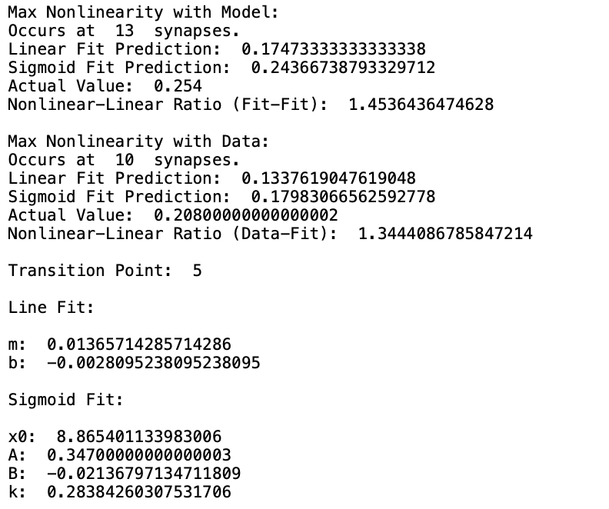
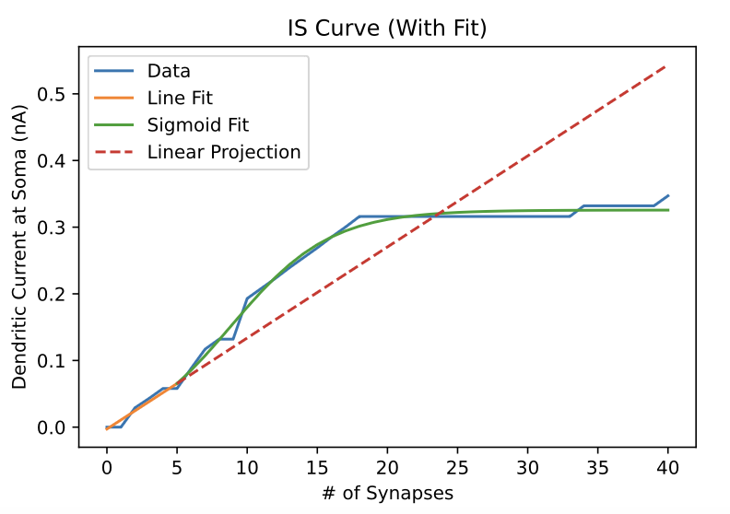
CASE #1:
Conductance: 0 µS
Steady Current: 1.10 nA

Slide 6
CASE #2:
Conductance: 0.0025 µS
Steady Current: 1.5 nA

Slide 7
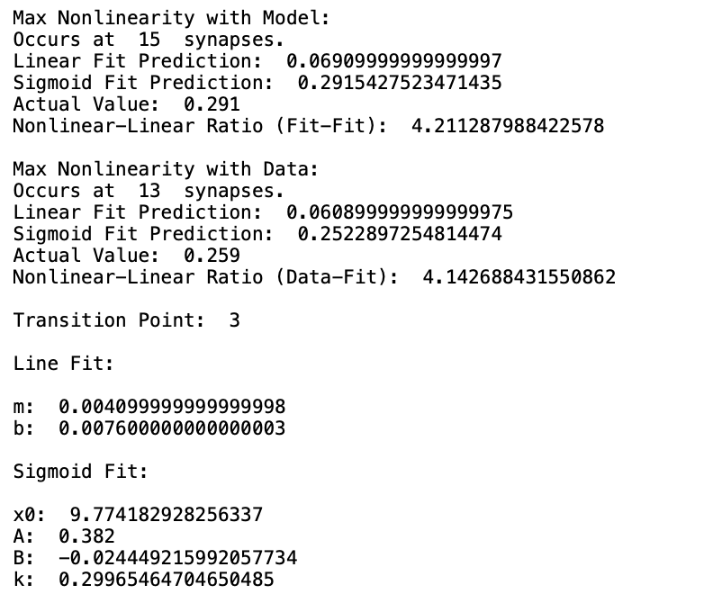
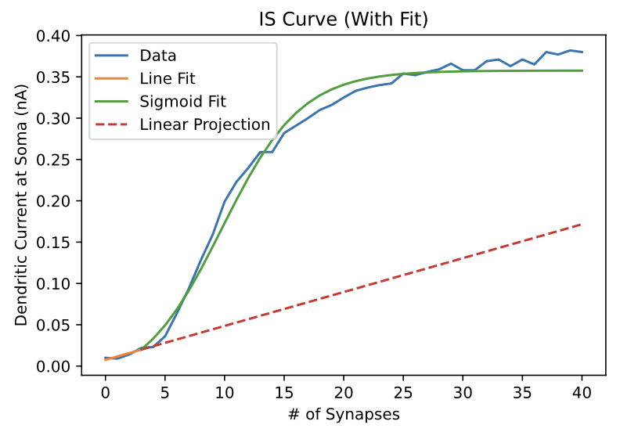
CASE #2:
Conductance: 0.0025 µS
Steady Current: 1.5 nA

Slide 8
CASE #3:
Conductance: 0.005 µS
Steady Current: 1.875 nA

Slide 9
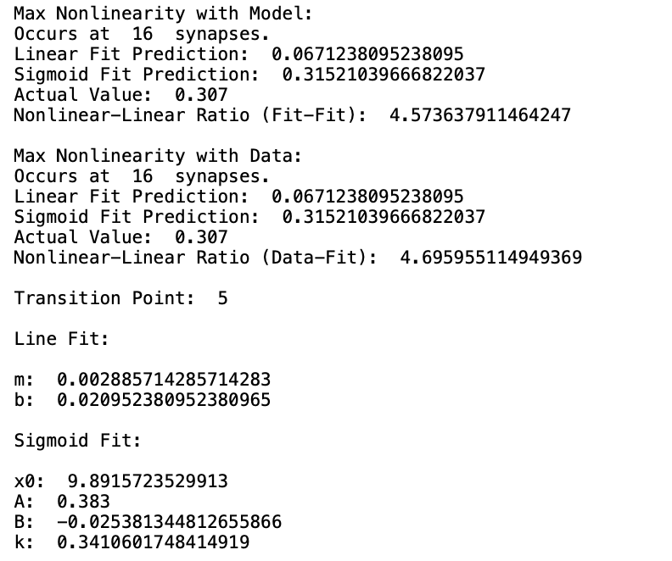
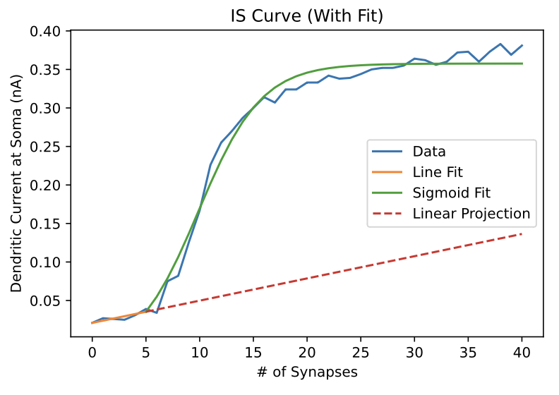
CASE #3:
Conductance: 0.005 µS
Steady Current: 1.875 nA

Slide 10
CASE #4:
Conductance: 0.01 µS
Steady Current: 2.52 nA

Slide 11
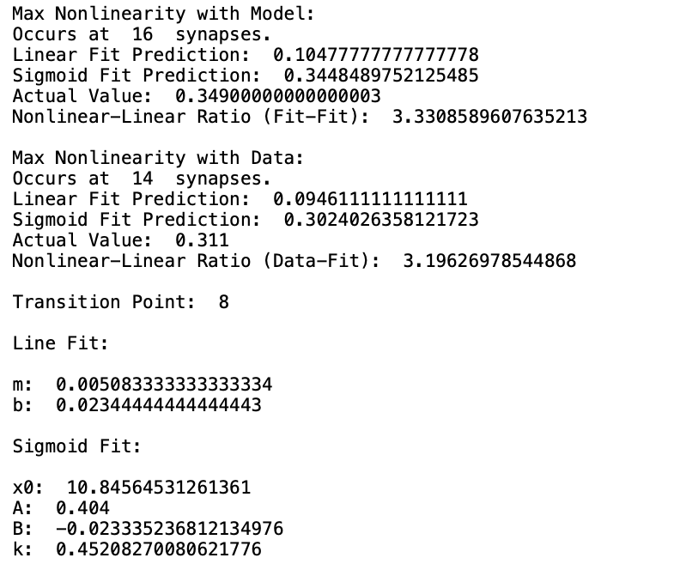
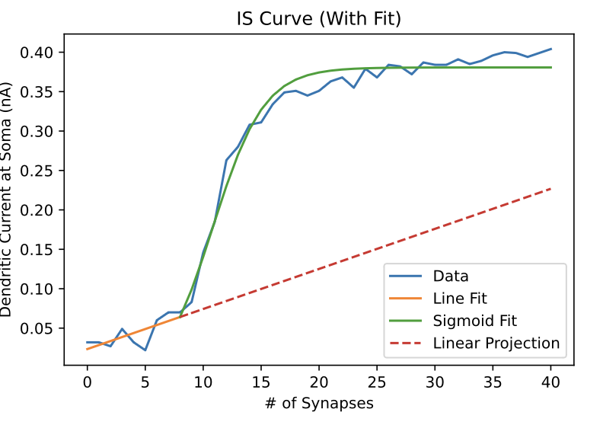
CASE #4:
Conductance: 0.01 µS
Steady Current: 2.52 nA

Slide 12
CASE #5:
Conductance: 0.02 µS
Steady Current: 3.625 nA

Slide 13
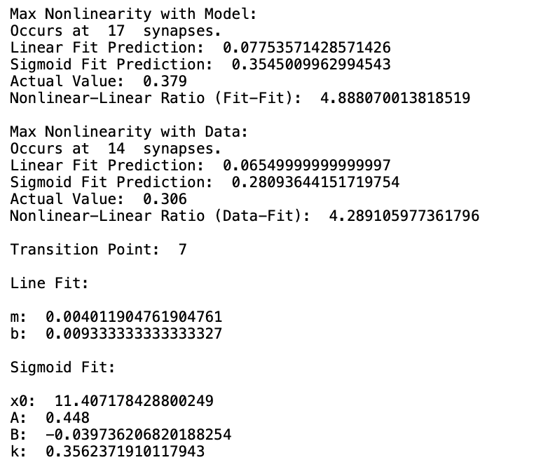
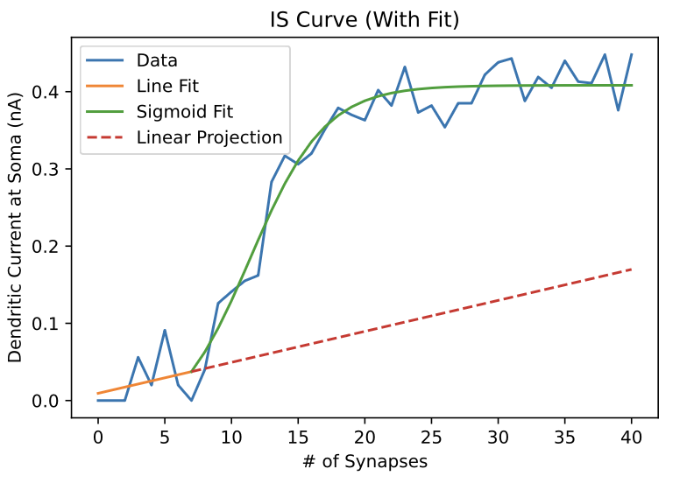
CASE #5:
Conductance: 0.02 µS
Steady Current: 3.625 nA

Slide 14
CASE ANALYSIS
Would like to investigate within the 0 – 0.01 range, which seems to be the most responsive.

